Slide 1

Drone Data Analysis
Data Processing and Visualization Samples
Guada Casuso
Notes:
Additional slide for IoT Hub.

Slide 2
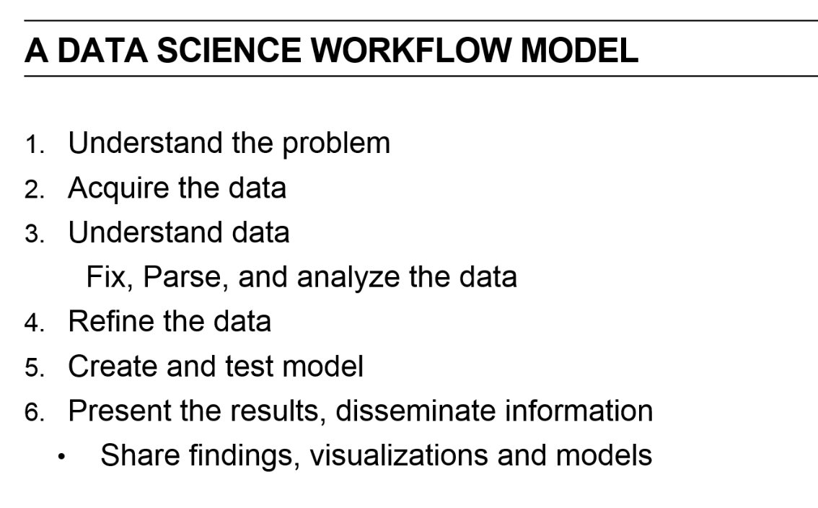

Slide 3
In any autonomous flight mission, the number of UAVs needed to accomplish a mission is very important in order to keep SLA of the Service.
As an example, think about Fire Rescue: several considerations need to be taken to define the right number of units that can perform de Job.
Environmental conditions such as Weather, Season, Territory coverage extension, Altitude, Closeness to the water can influence the Drone Performance.
Drone Data: Battery Capacity, Sensors Information, etc.
First question to answer will be: How many drones do I need in a fleet to accomplish a mission?
A mission can be a fire rescue, a monitoring service, an agriculture scenario, etc.

Slide 4






UAS Components
Drone
Sensors: Accelerometer, Giroscope, magno meter, Ultrasound
Ground Base
Thermal / Infrared camera
Cloud Services
Reports
Notes:
Additional slide for IoT Hub.

Slide 5

The Federal Aviation Administration (FAA)
Different Types of UAS Operations
Public Operations (Governmental)
Civil Operations (Non-Governmental)
Model Aircraft (Hobby or Recreation only)
You can view and search the registration data at: http://www.faa.gov/foia/electronic_reading_room/media/Reg-by-City-State-Zip-12May2016.xlsx

Slide 6
First question to answer will be: What is the type of UAV that most likely will get an exception for commercial applications?

Slide 7


Acquiring the data
My Data source will be:
https://github.com/voxmedia/data-projects/tree/master/verge-drones-over-america

Slide 8
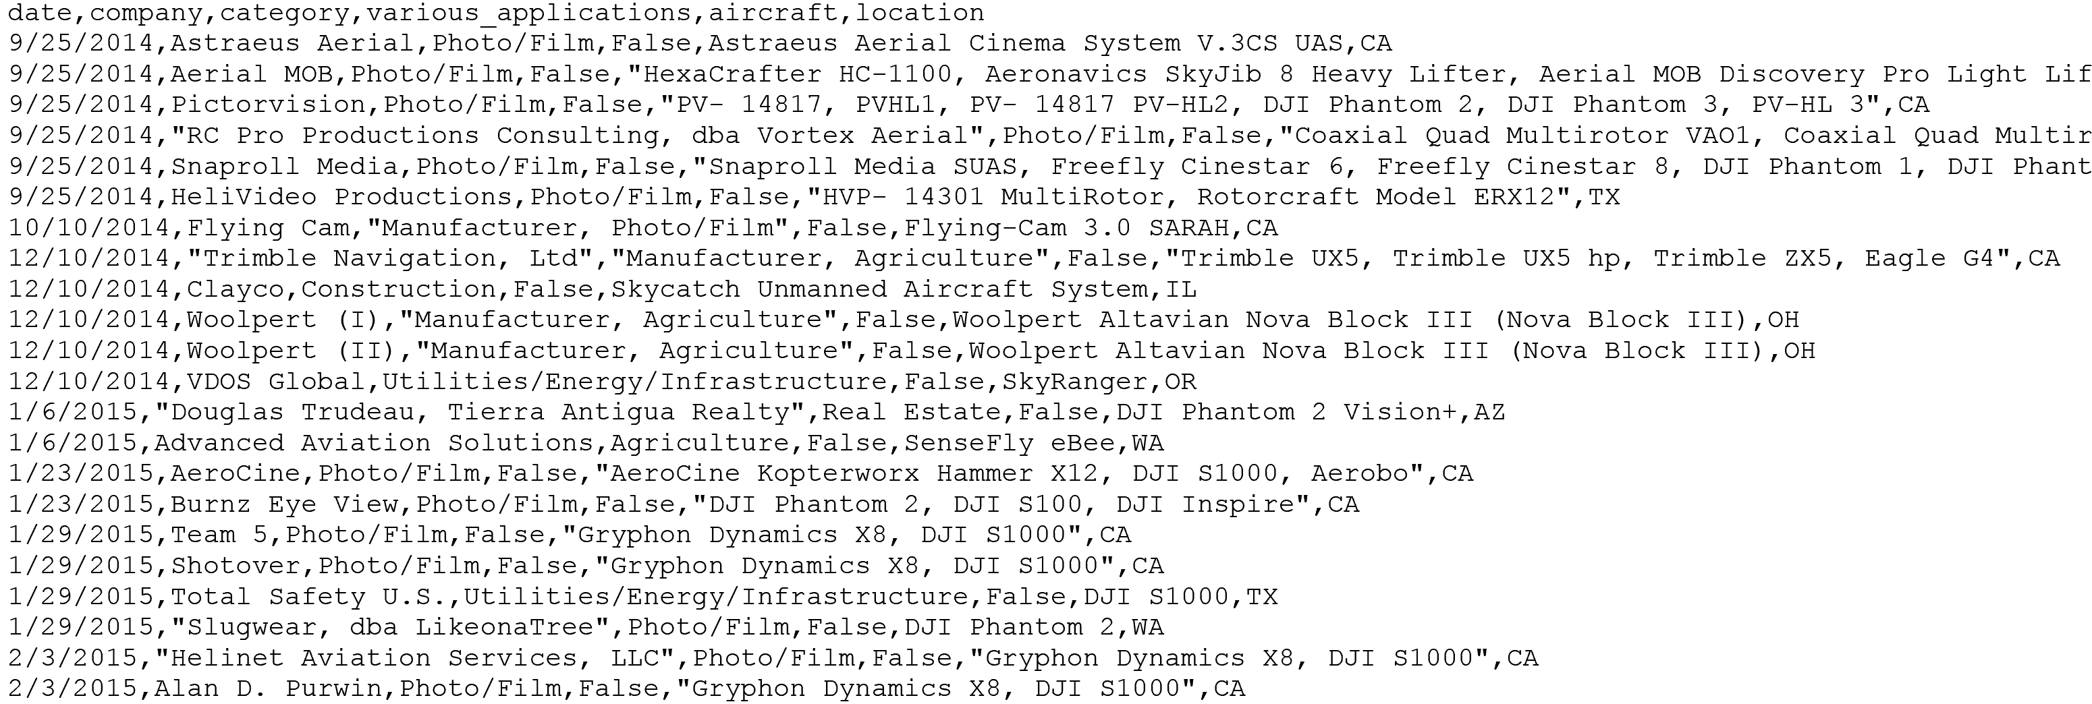
Understanding the Data

Slide 9
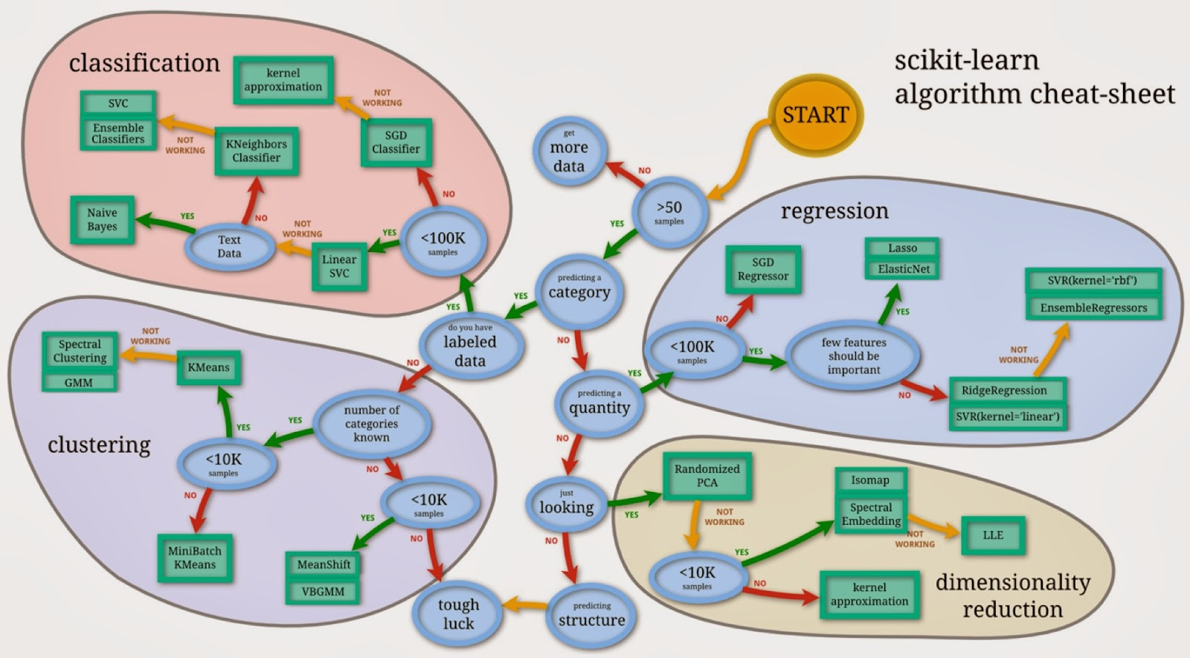


Slide 10
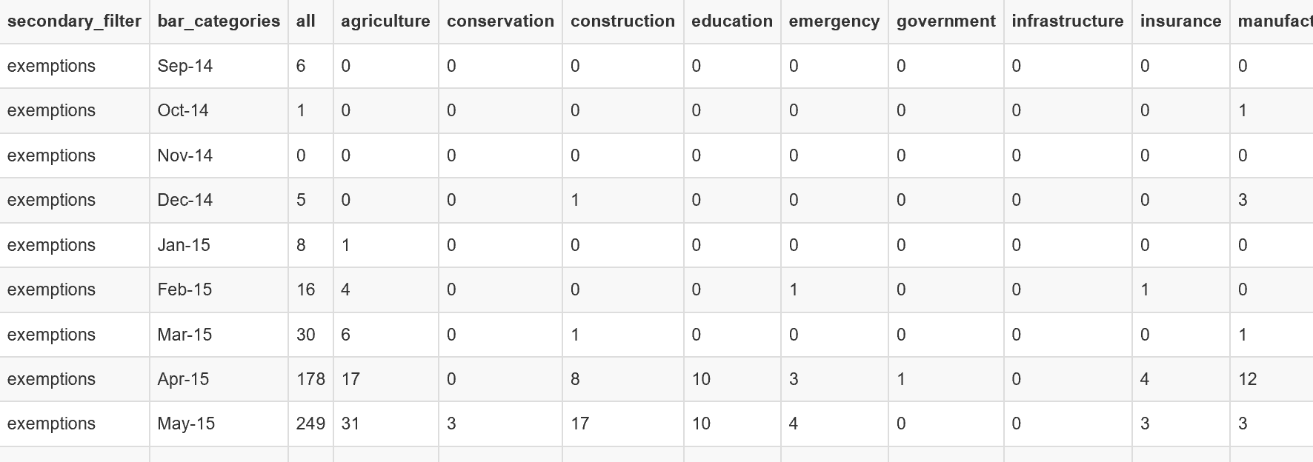
Refining the Data

Slide 11
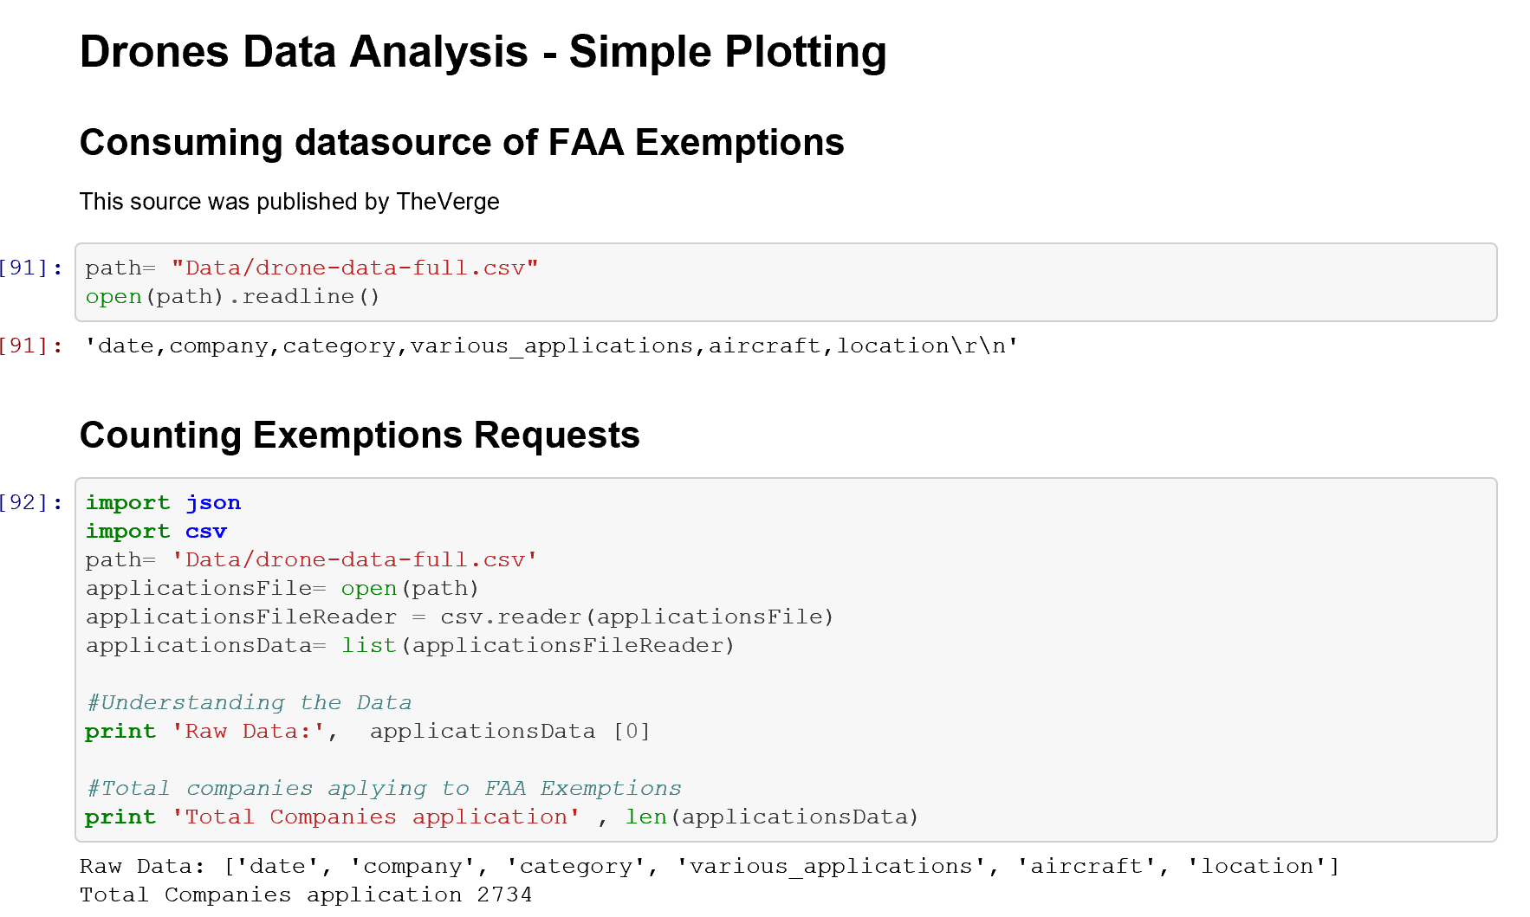
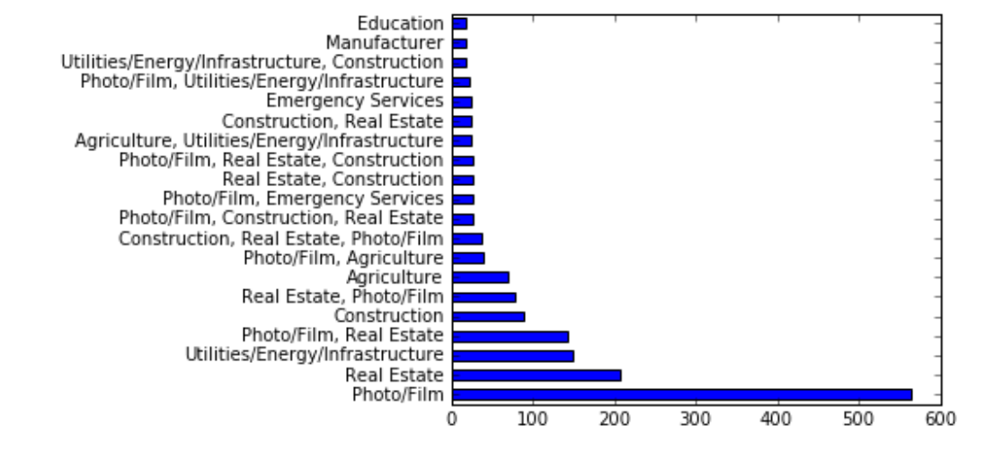
Create and Test the Model
2733 observations (n=2733): each observation is one FAA Exemption
3 features (p=3): Status, Use, UAV Type Response: Drone Type
Classification problem since response is categorical

Slide 12
Training / Testing Set
Training: FAA Approvals
Testing: FAA Queue
Labels: Fixed Wings, Quadcopters
K=2

Slide 13
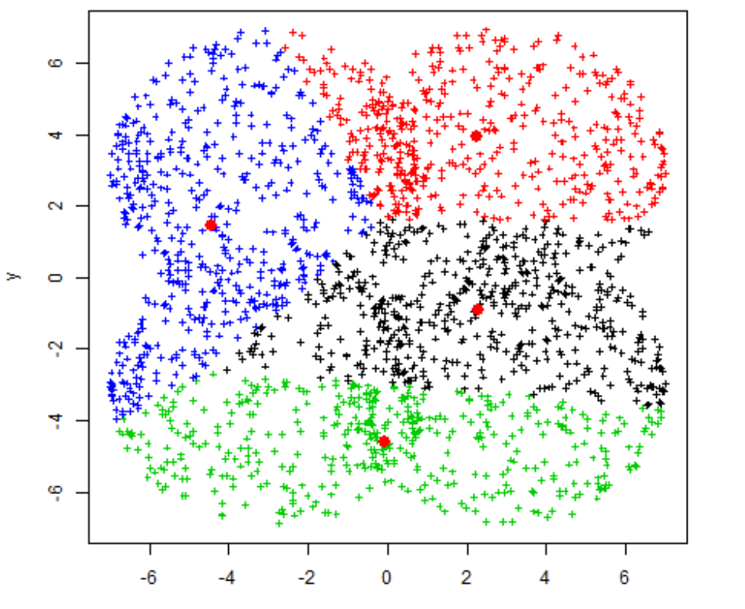
How popular the category is?
Agro
Photo/Film
Quadcopters
Fixed Wings
Education
How likely to be approved the category is?
Construction
Real Estate
Government
Utilities/Energy/
Infrastructure

Slide 14



Architecture
FAA Train Data
FA Test Data

Slide 15
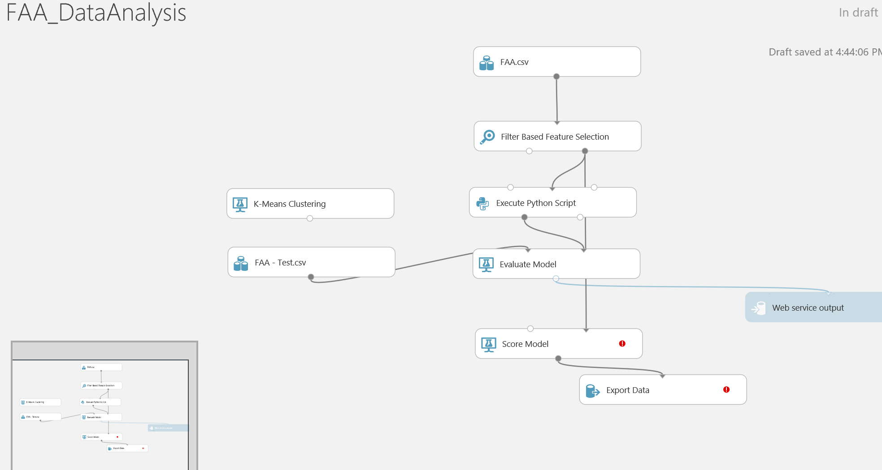
Using Azure ML

Slide 16
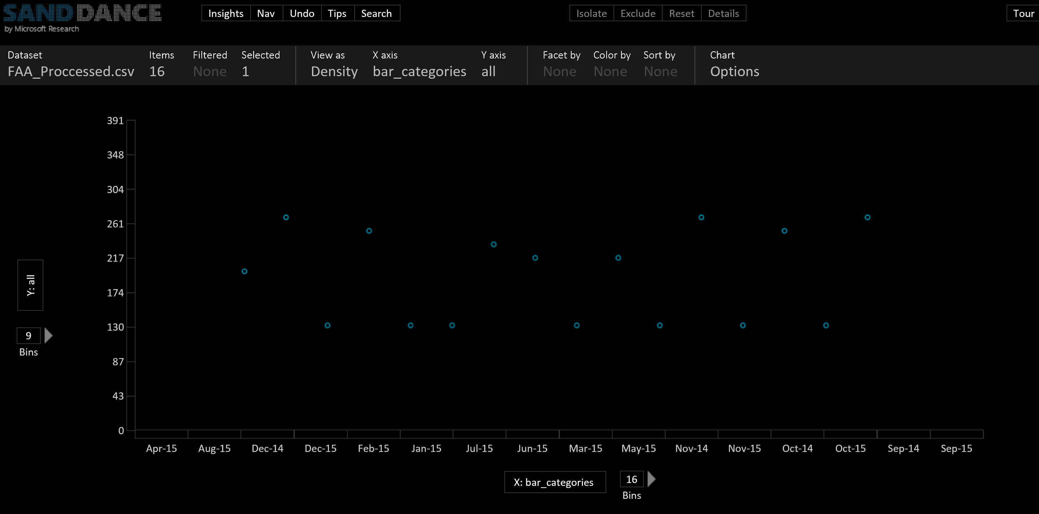
Present the Data

Slide 17
SWOT
Advantages of KNN:
Simple to understand and explain
Model training is fast
Can be used for classification and regression
Disadvantages of KNN:
Must store all of the training data
Prediction phase can be slow when n is large
Sensitive to irrelevant features
Sensitive to the scale of the data (for some distance metric options)
Accuracy is (generally) not competitive with the best supervised learning methods

Slide 18
What’s Next?
First question to answer will be: How many drones do I need in a fleet to accomplish a mission?
A mission can be a fire rescue, a monitoring service, an agriculture scenario, etc.
Refining the Data
Create and Test the Model
Present the Results

Slide 19


Architecture
Flight Data
Azure Document DB
Weather

Slide 20
Thanks!!

Slide 21
Appendix

Slide 22
Acquiring the data
My Data sources will be:
For weather I will use the underground Public Datasource https://www.wunderground.com/weather/api/d/docs?MR=1
The Flight Data that is here and also I will need to add some other measurements such as Battery and Sensors operation.

Slide 23
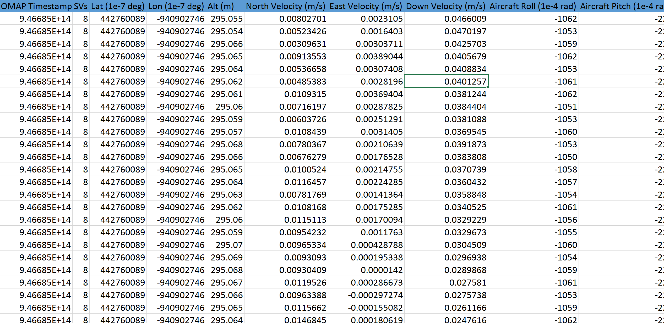
Understanding the Data

Slide 24
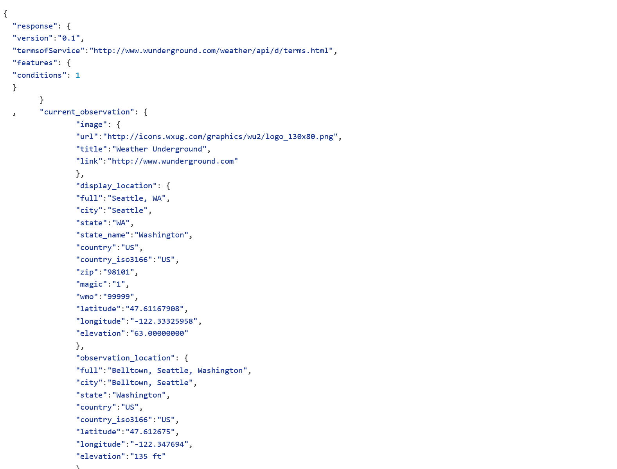
Understanding the Data
http://api.wunderground.com/api/1150673d7b3a40f6/conditions/q/CA/San_Francisco.json
https://github.com/guadacasuso/DroneDataAnalytics/blob/master/Data/SeattleWeather.json

Slide 25
Feature Selection
Season
Location
Equipment
Battery type
-> Time flying
Hectares to cover and Hs of operation vrs #drones

Slide 26
